Slide 1
Work Progress
By: Abdur Rehman

Slide 2
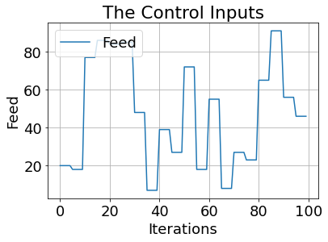
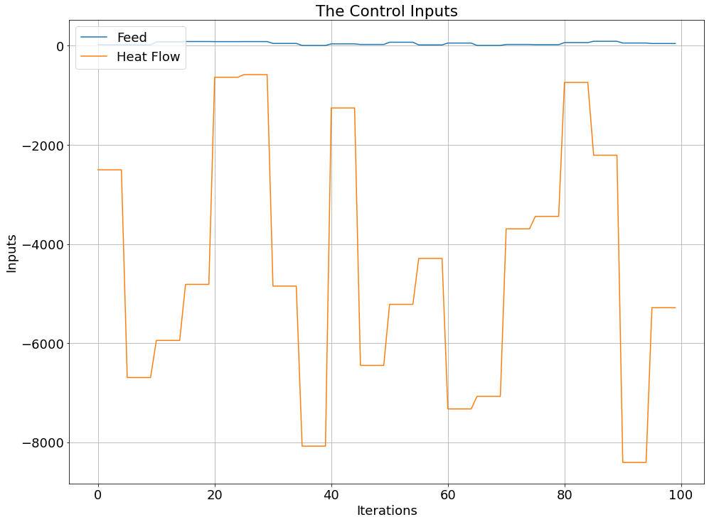
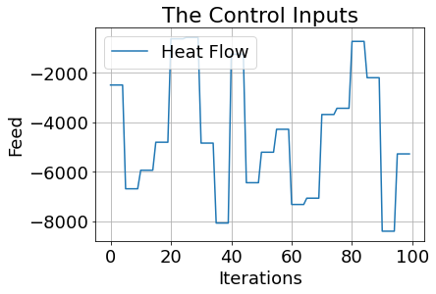

Visualizing the Inputs and Outputs
The control inputs are the feed F and the heat flow$\dot{ Q }$:

Slide 3
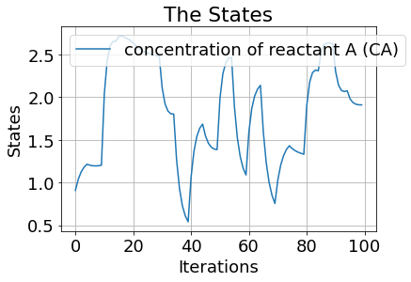
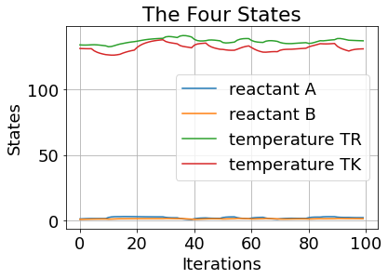
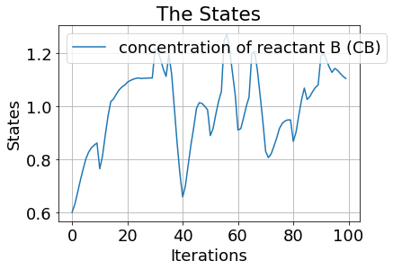
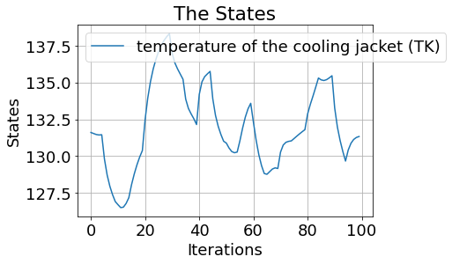
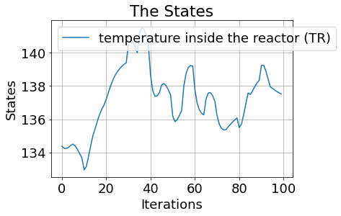
The four states are concentration of reactant A (CA), the concentration of reactant B (CB), the temperature inside the reactor (TR) and the temperature of the cooling jacket (TK):

Slide 4
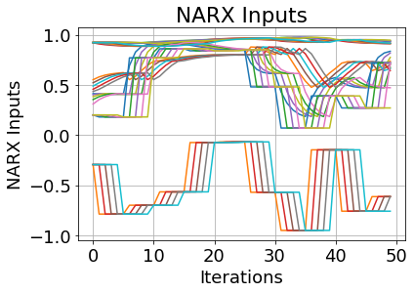
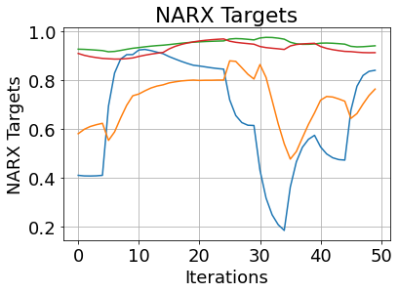

The First NARX Concatenation
nU_delay = int(5)
nY_delay = int(5)
Inputs:
inputs.shape : (3595, 30)
print(inputs):
Targets:
print(targets.shape): (3597, 4)
print(targets):

Slide 5
Keras-Tuner: Hyperparameter Optimization Framework
Tune The Model Architecture:
The first thing we need to do is writing a function, which returns a compiled Keras model. It takes an argument hp for defining the hyperparameters while building the model.
The parameters expected to be tuned:
Number Of Hidden Layers
range(hp.Int('hidden_layers', 2, 50))
Number Of Neurons
units=hp.Int('units_nodes_' + str(i), min_value=32, max_value=1024, step=32)
Activation Functions
activations=hp.Choice('activation_', ["relu", "tanh", "sigmoid"])
activation=activations
Learning Rate
hp.Choice('learning_rate', [1e-1, 1e-2, 1e-3, 1e-4, 1e-5])
Optimizers Used ADAM:
optimizer=tf.keras.optimizers.Adam
Metrices Considered:
metrics=['mean_squared_error', 'mean_absolute_error', 'mean_absolute_percentage_error', 'cosine_proximity’, tf.keras.metrics.RootMeanSquaredError()]
Loss: 'mean_absolute_error'

Slide 6
Results 1:
tuner.results_summary()
Best Tuning Parameters:
History Test
cosine_proximity | 1.9535999298095703
loss | 0.1259947121143341
mean_absolute_error | 0.1259947121143341
mean_absolute_percentage_error | 25.792282104492188
mean_squared_error | 0.0384749211370945
History Train
cosine_proximity | 1.9608268737792969
loss | 0.11988405138254166
mean_absolute_error | 0.11988405138254166
mean_absolute_percentage_error | 21.963226318359375
mean_squared_error | 0.03344341367483139

Slide 8
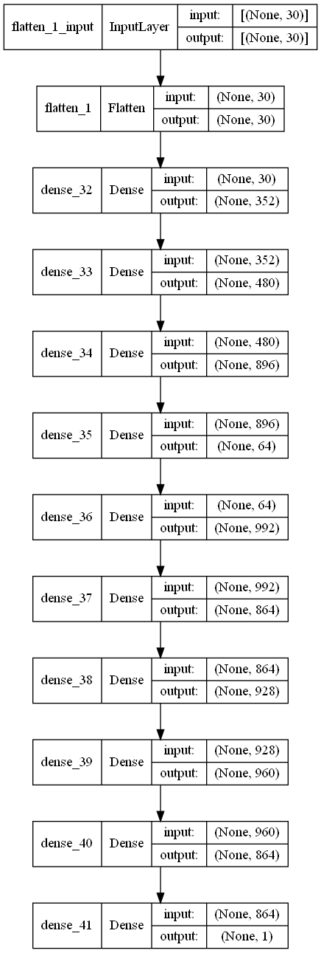

Slide 9
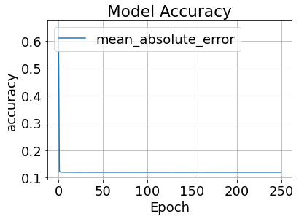
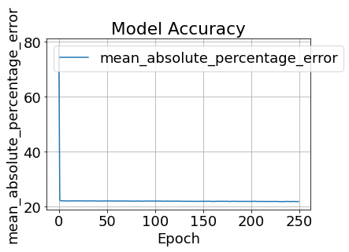
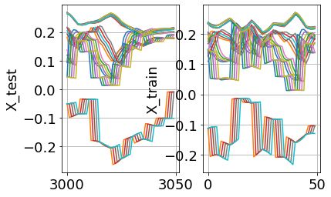
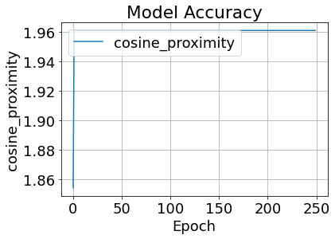
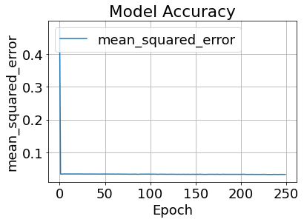
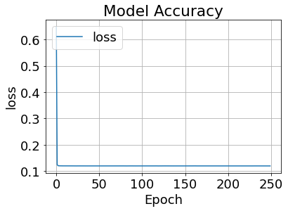
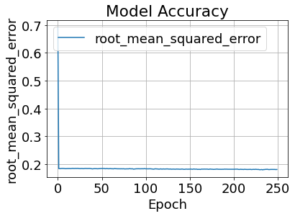

Slide 10
CHANGE OF NARX MODEL NUMBER 2

Slide 11
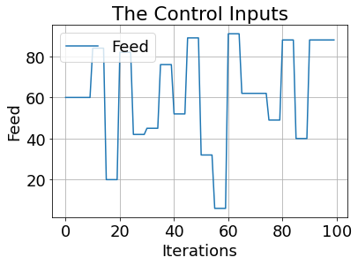
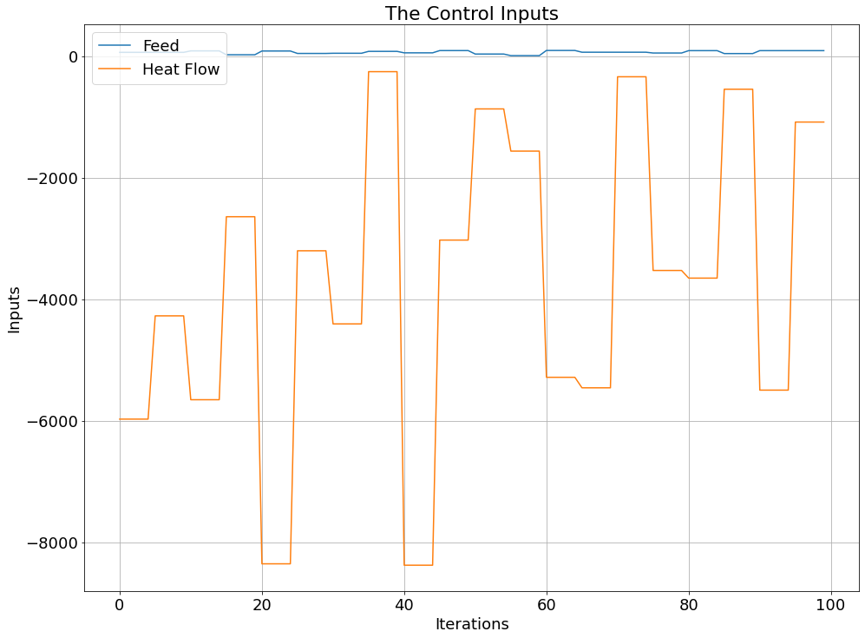
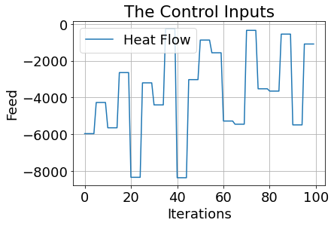
The control inputs are the feed F and the heat flow$\dot{ Q }$:

Slide 12
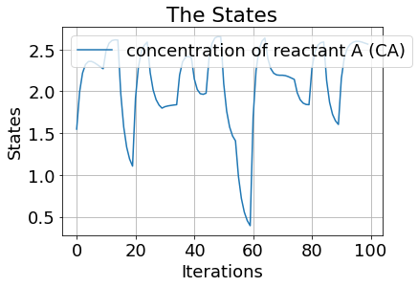
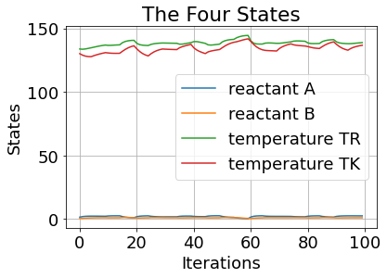
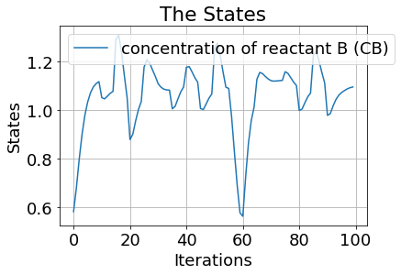
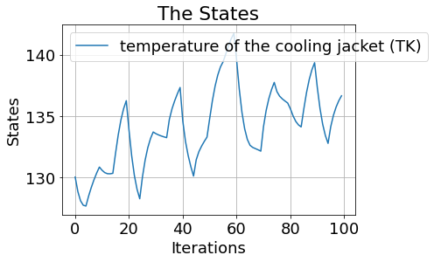
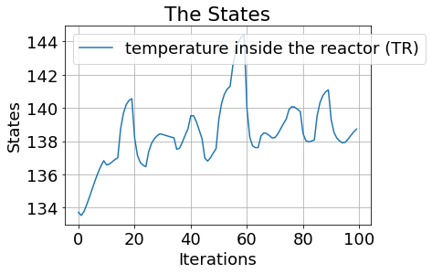
The four states are concentration of reactant A (CA), the concentration of reactant B (CB), the temperature inside the reactor (TR) and the temperature of the cooling jacket (TK):

Slide 13
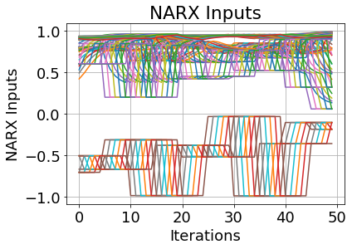
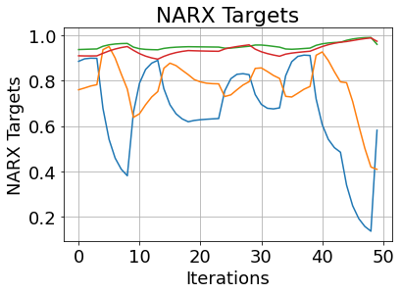
The First NARX Concatenation
nU_delay = int(11)
nY_delay = int(11)
Inputs:
inputs.shape :(3589, 66)
print(inputs):
Targets:
print(targets.shape): (3597, 4)
print(targets):

Slide 14
Results 2:
tuner.results_summary() :
Best mean_absolute_error So Far: 0.12036397829651832
Total elapsed time: 13h 43m 43s
Best Tuning Parameters:
History Test
cosine_proximity | 1.9517712593078613
loss | 0.13125687837600708
mean_absolute_error | 0.13125687837600708
mean_absolute_percentage_error | 26.84868049621582
mean_squared_error | 0.04015705734491348
History Train
cosine_proximity | 1.9596658945083618
loss | 0.1202477216720581
mean_absolute_error | 0.1202477216720581
mean_absolute_percentage_error | 22.5994873046875
mean_squared_error | 0.03423559293150902

Slide 16
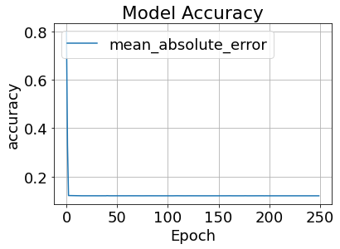
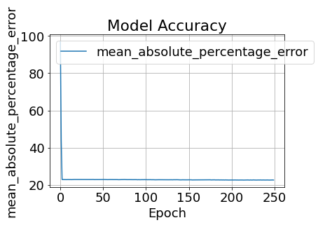
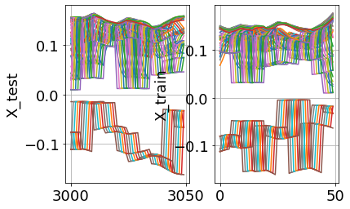
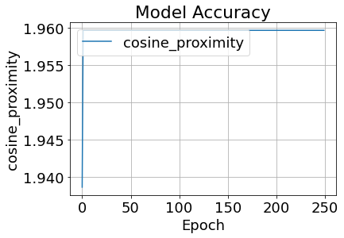
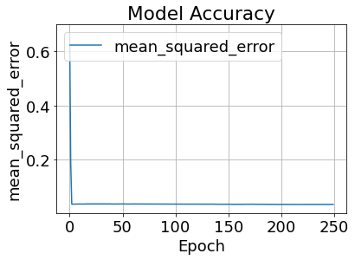
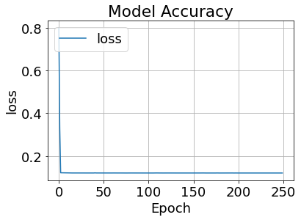
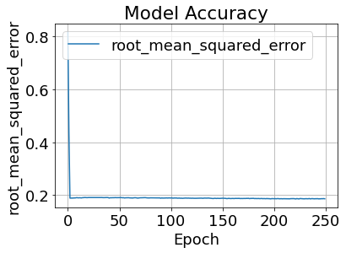

Slide 17
CHANGE OF NARX MODEL NUMBER 3

Slide 18
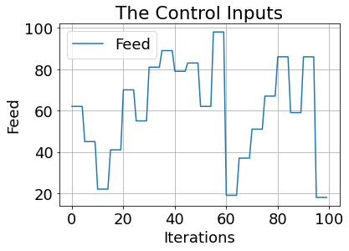
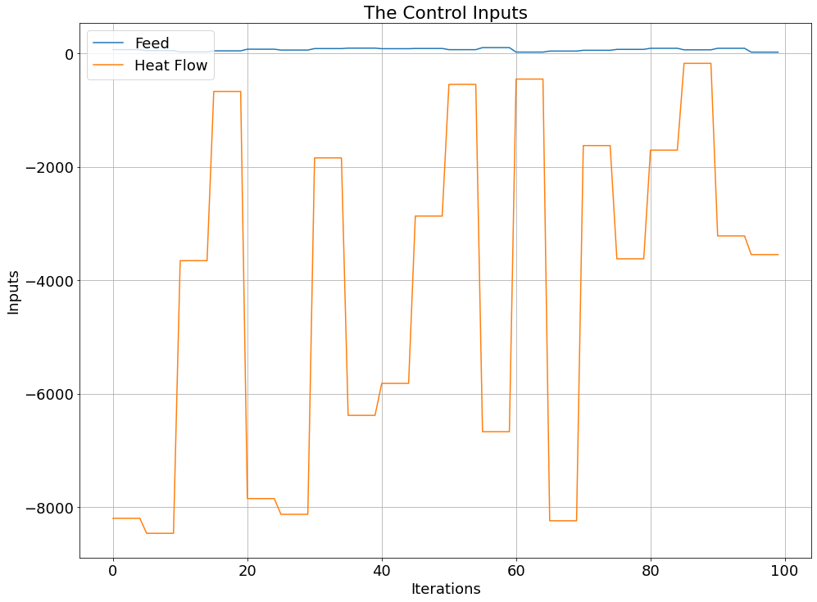
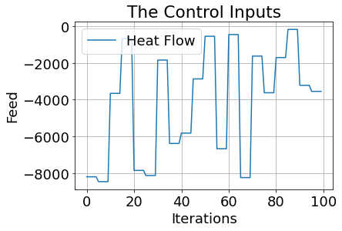
The control inputs are the feed F and the heat flow$\dot{ Q }$:

Slide 19
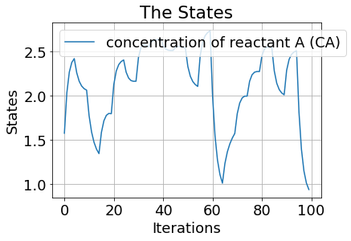
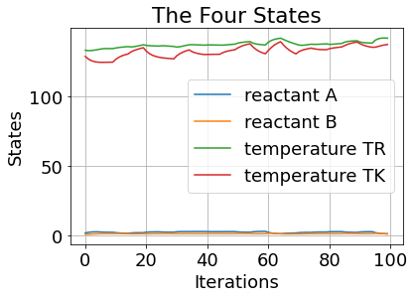
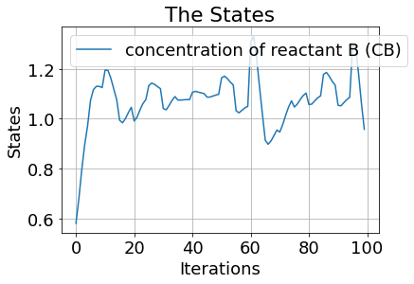
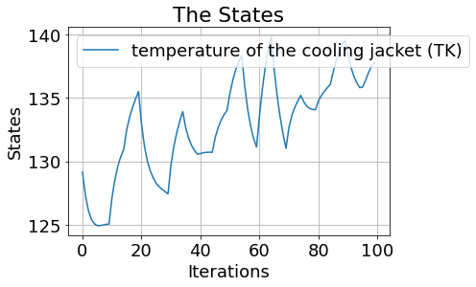
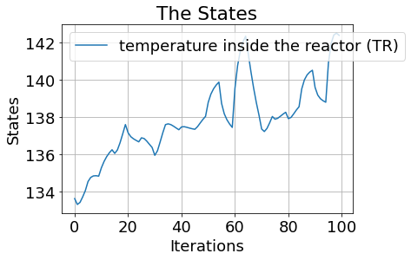
The four states are concentration of reactant A (CA), the concentration of reactant B (CB), the temperature inside the reactor (TR) and the temperature of the cooling jacket (TK):

Slide 20
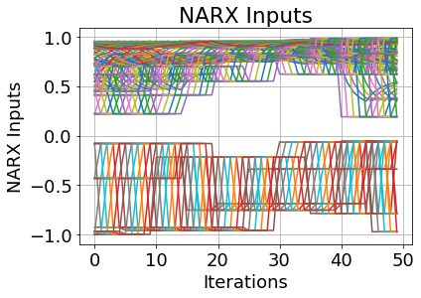
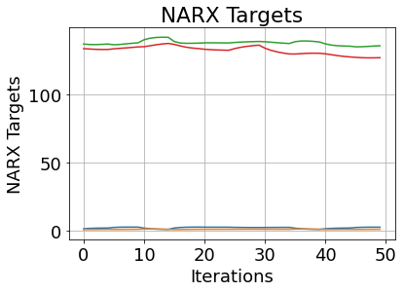
The First NARX Concatenation
nU_delay = int(21)
nY_delay = int(21)
Inputs:
inputs.shape : (3579, 126)
print(inputs):
Targets:
print(targets.shape): (3597, 4)
print(targets):

Slide 21
Results 3:
tuner.results_summary() :
Best mean_absolute_error So Far: 0.12051623687148094
Total elapsed time: 14h 20m 55s
Best Tuning Parameters:
History Test
cosine_proximity | 1.9600868225097656
loss | 0.12212243676185608
mean_absolute_error | 0.12212243676185608
mean_absolute_percentage_error | 22.46921730041504
mean_squared_error | 0.03521865978837013
History Train
cosine_proximity | 1.9595807790756226
loss | 0.12025561183691025
mean_absolute_error | 0.12025561183691025
mean_absolute_percentage_error | 22.71456527709961
mean_squared_error | 0.035590119659900665

Slide 23

